Slide 1
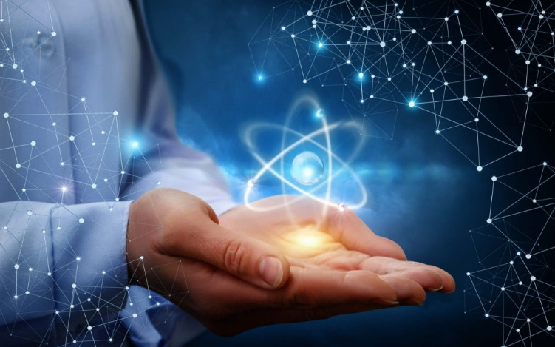
THE ORIGINS OF SARI & XLNT
Scientists for Accurate Radiation Information & XLNT Foundation
Mark Miller CHPª, Doug Osborn, PhDª, Bobby Scott PhD^{b}, Bert Morales CHP, ^{c} and Mohan Doss PhD^{d}
(ª- Sandia National Laboratories, ^{b} - LRRI, Retired, ^{c} - UniTech, ^{d} - Fox Chase Cancer Center)
Presented at: “Applicability of Radiation-Response Models to Low Dose Protection Standards”, Tri-Cities, WA 9/30-10-3, 2018
Notes:
Make this slide be the “banner” for the 4X4 poster.

Slide 2
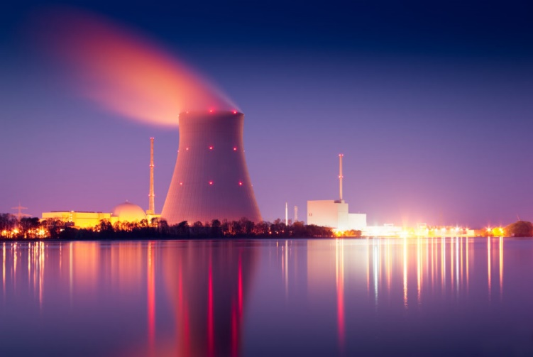
… IT ALL STARTED WHEN…
Fukushima, 3/11/11
Misinformation
Radiophobia
Little scientific rigor in news
Scaremongering
Desire to SAVE lives, NOT cause more suffering/death
Notes:
Top left slide #1
It all started when several colleagues were bemoaning the misinformation and scare mongering that was occurring after the Fukushima accident

Slide 3

CHARTER
The objective of this group is to monitor for and counter nuclear/radiological misinformation that could adversely impact the world’s ability to effectively respond to nuclear and radiological challenges, to the end point of saving lives.
For the world to effectively prepare for and respond to a radiological or nuclear emergency, it is important to have reliable information about risks to humans from both high- and low-level exposures to ionizing radiation and that the general response to the human body from high and low doses is different. Unfortunately, misinformation (such as the linear, no-threshold model (LNT)) about radiation effects on humans is prevalent in the news and other media, especially for low-level-radiation exposure (low-dose and low-dose-rate), as is currently the case for downwind populations of Fukushima.
Misinformation (such as the LNT) if not quickly detected and properly countered by reliable information in a timely manner can lead to harm including the unintended loss of many lives as has been demonstrated after the Chernobyl and Fukushima accidents. Misinformation related to low-level radiation exposure leads to unintended fatalaties¹. Our group is multidisciplinary and includes expertise in a variety of areas including radiation source characterization, radiation transport, external and internal radiation dosimetry, radiobiological effects (both harmful and beneficial), dose-response modeling, radiation risk and benefit assessment, nuclear medicine, diagnostic radiology, radiation oncology, commercial nuclear power, technology supporting use of nuclear power, isotope production, and nuclear/radiological emergency management.
¹ Fear based on the LNT was responsible for about 100,000 abortions following the Chernobyl accident and is now also responsible for more than 1,000 lives being lost related to Fukushima evacuations (Scott BR and Dobrzyński L. 2012.
Dose-Response 10:462-466). https://www.ncbi.nlm.nih.gov/pmc/articles/PMC3526320/
Notes:
#2, second left slide
SARI’s objective is monitor for and counter misinformation when members become aware of it. Only short, concise rebuttals are intended.

Slide 4
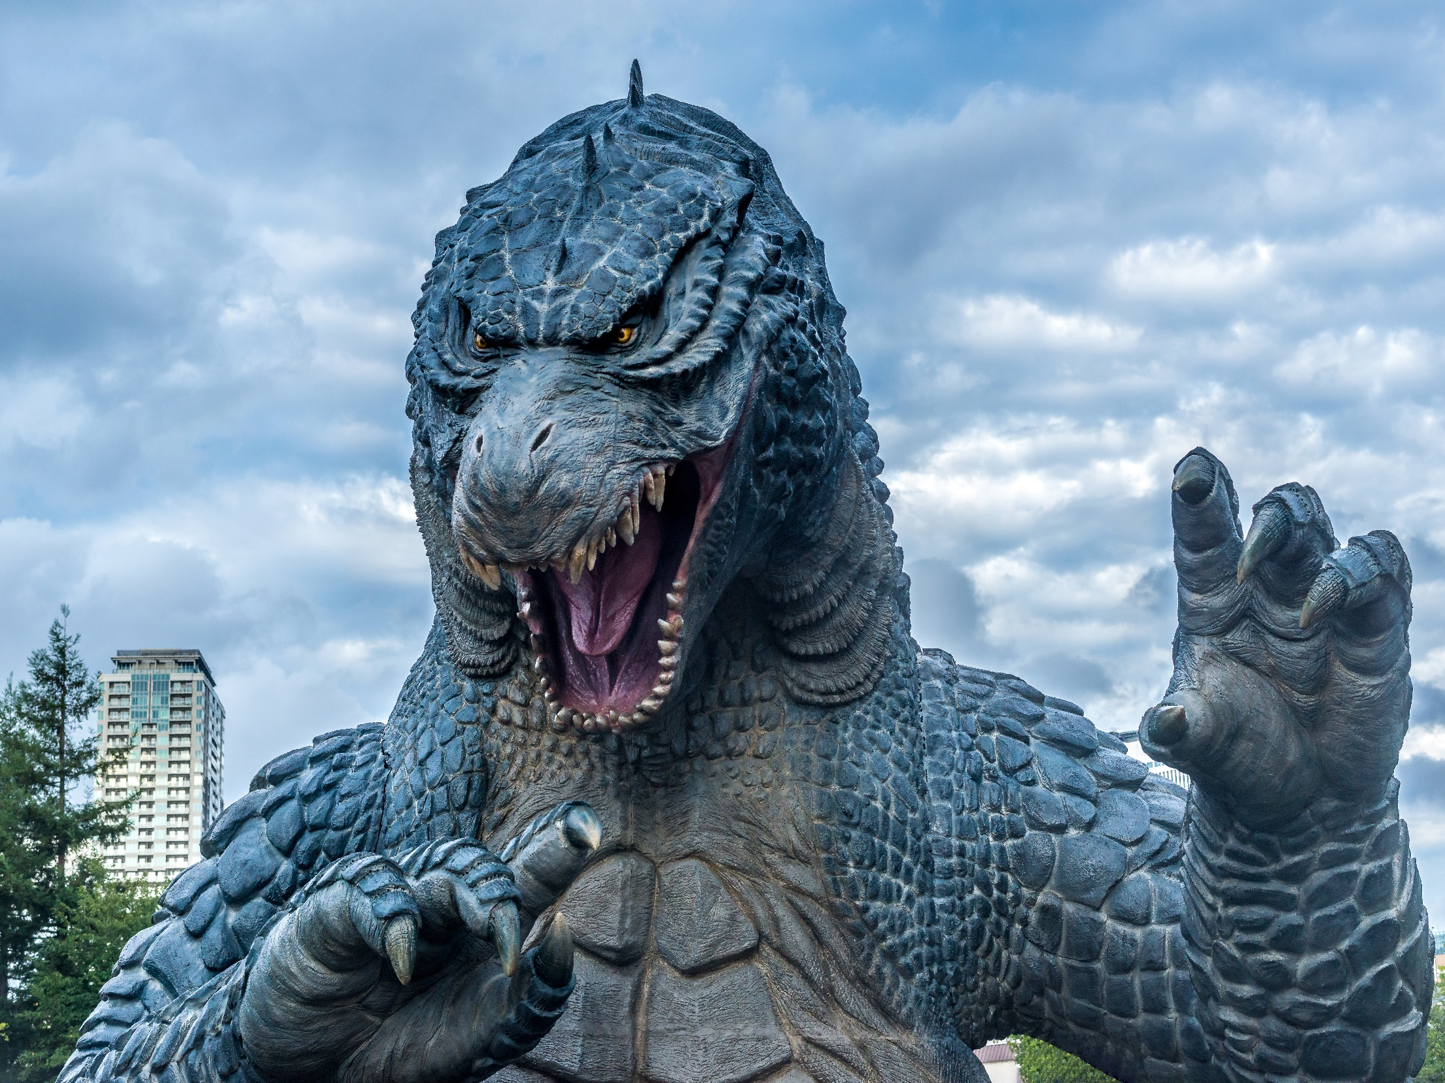

MISSION
To help prevent unnecessary, radiation-phobia-related deaths, morbidity, and injuries associated with distrust of radio-medical diagnostics/therapies and from nuclear/radiological emergencies through countering phobia-promoting misinformation (such as the LNT) spread by alarmists via the news and other media including journal publications.­­­­­­­­­­­­­­­­­­­­­­­­­­­­­­­­­­­­­­­
Notes:
#3, 3rd left slide
Re-establish trust in SCIENCE and enable beneficial uses of radiation such as in medicine and nuclear power!

Slide 5

CONCISE, ACCURATE REBUTTALS
Efficacious use of technically accurate responses by “working professionals”
Perhaps only “ten” (or so) fundamental tenets of scare stories or mis-statements
Catalog of carefully crafted responses from which to craft specific rebuttals, as they came to our awareness
SARI peer input to development of concise rebuttals
Notes:
#4, 4th left slide
Accurate and concise responses.
KISS principle whenever possible.

Slide 6

SARI COLLABORATION
SARI members hope to tap into the synergies that result from collaboration and association with like-minded individuals and organizations.
It is only with these associations will our combined efforts produce the desired result.
Notes:
Together Everyone Achieves More, T.E.A.M. !
Middle, top slide, below banner

Slide 7

SARI COLLABORATION EXAMPLES
Only a few years ago, any discussion of LNT or hormesis among members of the Health Physic Society was “politely ignored”
At the 2015 Annual Meeting, there was a 2-day Special Session on the topics! Standing Room Only!
MONDAY 3:00-6:00 PM Room 116 MPM-G: Special Session: Health Risks from Low Doses and Low Dose-Rates of Ionizing Radiation 3:00 PM Introduction by Feinendegen, L. , Brookhaven National Laboratory
TUESDAY 8:30 AM-12:00 PM Room 107 TAM-C: Special Session: Health Risks from Low Doses and Low Dose-Rates of Ionizing Radiation
2:30-5:30 PM Room 107 TPM-C: Special Session: Health Risks from Low Doses and Low Dose-Rates of Ionizing Radiation
Applicability of Radiation-Response Models to Low Dose Protection Standards - 2018. – HERE TODAY!
Notes:
Middle, second slide
LNT discussions were once “off limits”.
NOW, they are “front and center” in many professional meeting venues.

Slide 8
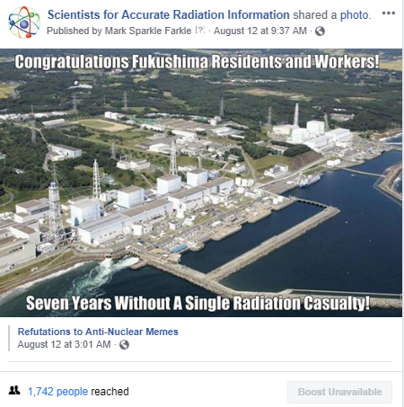
SOCIAL MEDIA EXPANDS THE MESSAGE
Notes:
3rd , Middle Slide
Social media is a great “force multiplier!
For example, Facebook readers “like” or “share” posted articles … … which can spread geometrically when reader’s “friends” further “like” or “share” them.

Slide 9

OPEN LETTERS TO ADVISORY BODIES
SARI drafted and sent several Open Letters to advisory bodies pointing out the scientific evidence against the LNT model and for radiation hormesis
These Open Letters were typically ignored by the advisory bodies. Occasionally, the advisory bodies would send Form Letters reiterating their position on the issue without engaging in a scientific discussion.
Notes:
4th , Middle Slide
SARI has written informational letters to various advisory bodies. So far, response SARI input is limited, but gaining credibility.

Slide 10
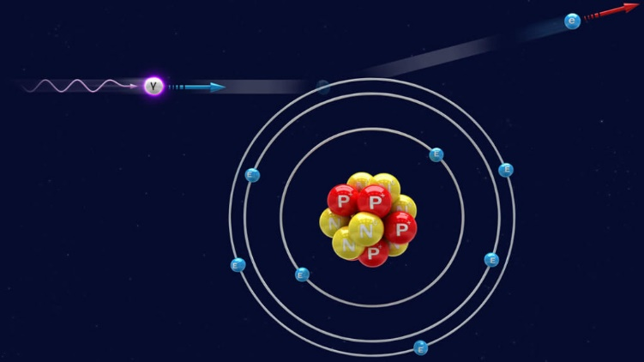
SARI PETITIONS TO NRC REGARDING THE LNT MODEL
In Feb., 2015: Carol Marcus, Mark Miller, & Mohan Doss (for SARI Members), initiated a Petition with NRC asking them to cease using the LNT model and use the radiation hormesis model for rulemaking
SARI submitted a NRC Petition – in support of Carol Marcus’s petition
NRC received public comments on the petitions until Nov., 2015. Letter from NRC in November 2017: “We’re still working on it!”
Outcome TBD, but professional community’s support has recently shifted as Accurate Radiation Information becomes widely known & understood.
Notes:
5th, middle slide (bottom)
SARI members have petitioned the NRC and the EPA to revise their unscientific LNT-based regulations.

Slide 11
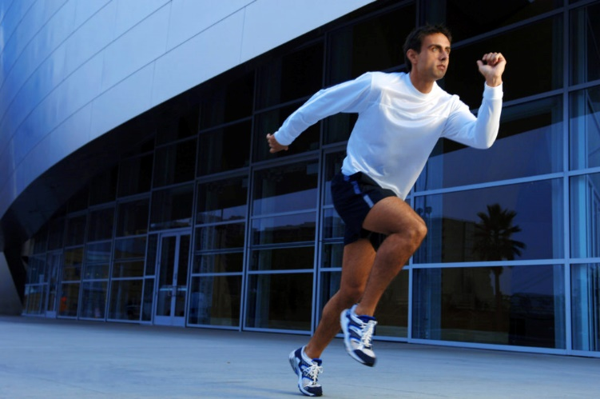
SARI ACCOMPLISHMENTS
Positives
SARI provides a world-wide forum for discussions of the health effects of radiation, LNT model, approaches to overcome fear of low-dose radiation, etc.
Negatives
SARI’s efforts have had little impact on regulations or advisory bodies’ recommendations so far, and are unlikely to have any direct impact
Conclusion: Providing accurate information regarding radiation is necessary for initiating a change but has not been sufficient. Additional steps are needed to engineer a change in radiation safety paradigm. SARI is not structured for undertaking additional actions such as fundraising, launch of lawsuits, etc.
New/additional organization is needed
(XLNT Foundation)
Notes:
Top Right Hand Slide, below banner slide
SARI influence and contribution to the debate is growing as SARI grows and matures.
Our insistence on accuracy is one of our guiding principles.

Slide 12
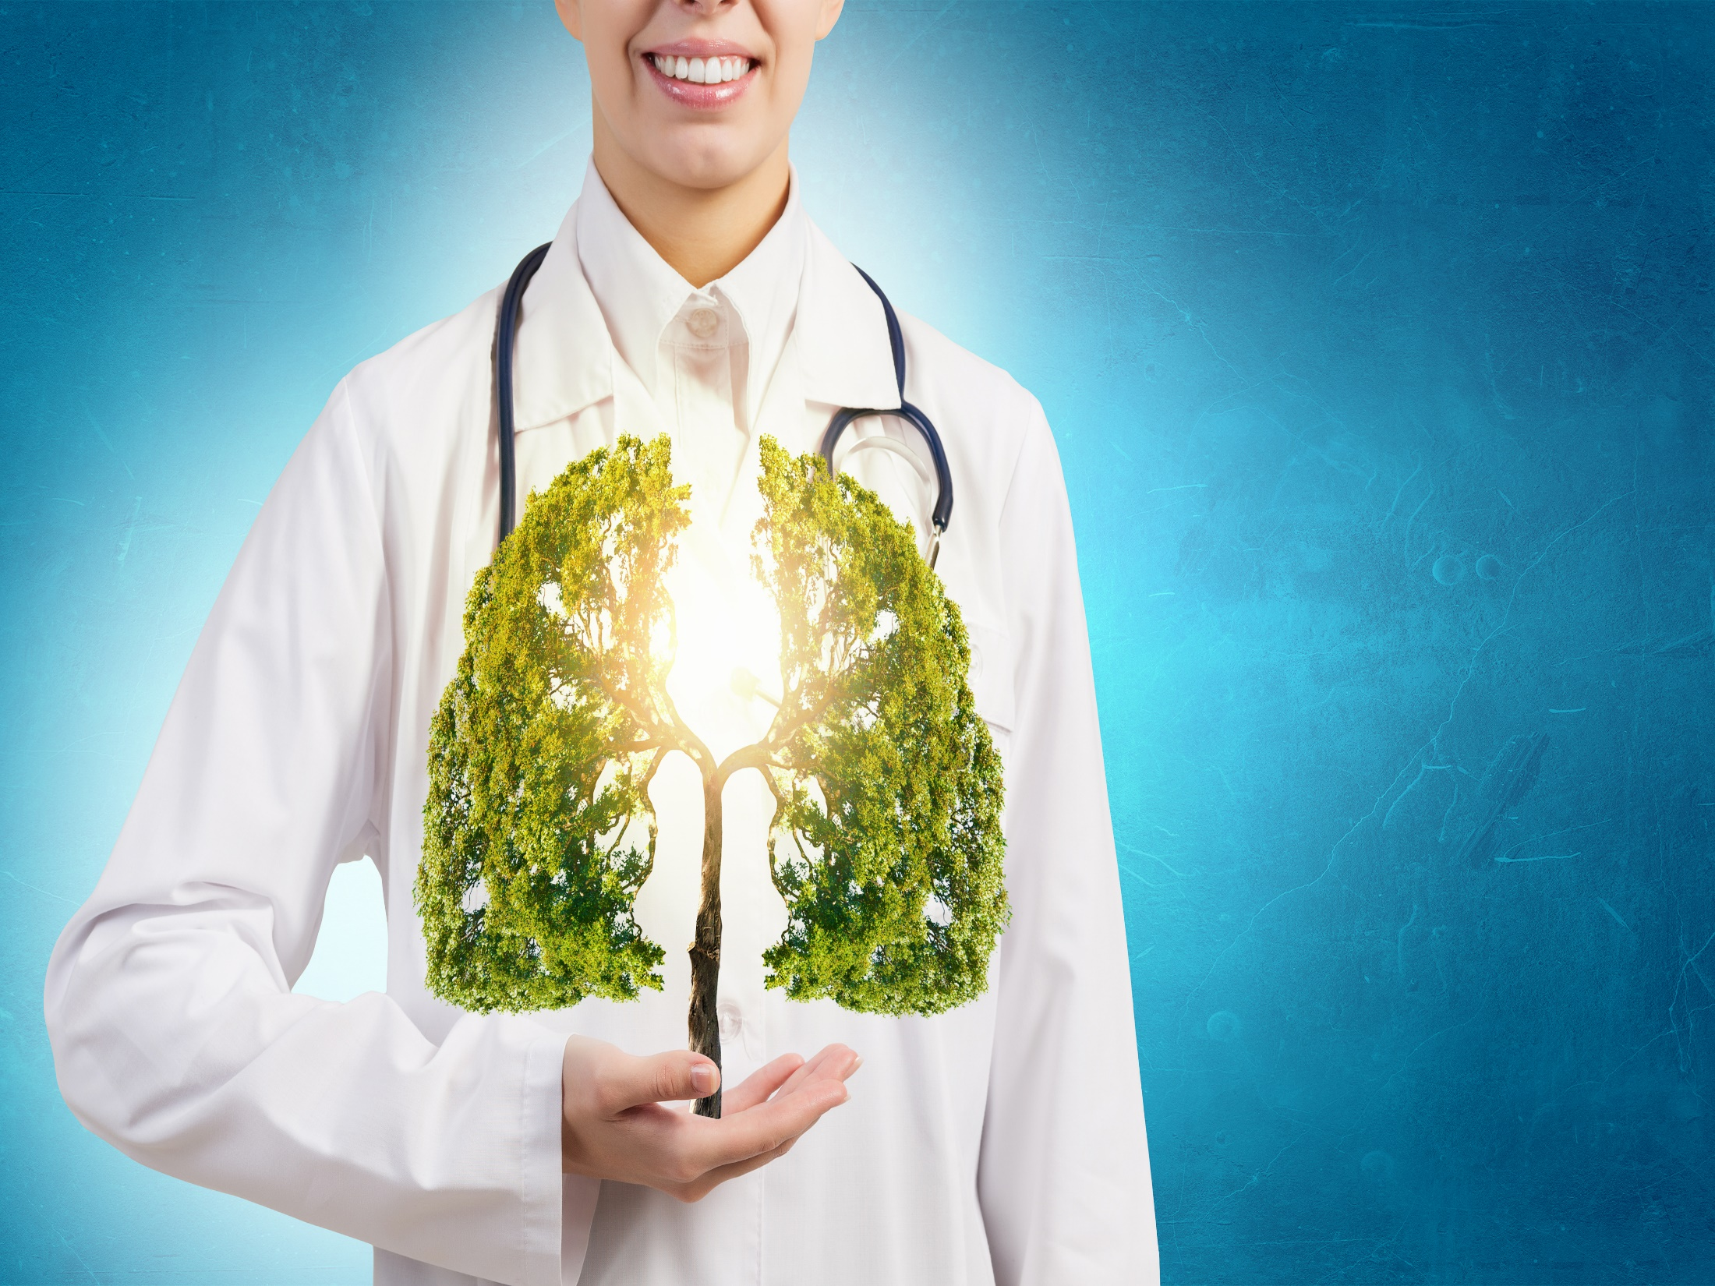
X-LNT FOUNDATION VISION & MISSION
The mission of the XLNT Foundation is to inform the public about the observed beneficial health effects of low-dose ionizing radiation, and to campaign for eliminating use of the linear no-threshold (LNT) model in order to enhance public health.
Our vision is a world in which the public, professionals, and governments are well informed about the observed beneficial effects of low-dose radiation and so utilize radiation without undue concerns based on the invalid LNT model. Our view is that discarding the LNT model would reduce the fear and concerns regarding low levels of radiation and facilitate a renaissance of radiation applications in health, energy, and other fields resulting in improved health, reduced energy costs, and sustainable economic development in developing countries.
Notes:
2nd Right hand slide
Where SARI is meant to address the informational and technical issues surrounding the LNT debate, XLNT was initiated to move the issue forward towards the elimination of the unscientific LNT.

Slide 13

SARI & XLNT FUTURE
Both are vibrant, forward-looking organizations focused on making the needed changes that will enable the world to realize the myriad beneficial uses of radiation in numerous, disparate avenues (power, medicine, science, etc.)
Join SARI and XLNT to add YOUR contribution to the initiatives and to learn LOTS!
Collaboration with other groups will result in synergies
Gmail
GoogleGroups for SARI & XLNT are great information-sharing threads for like-minded colleagues!
Notes:
3rd Right hand slide
Ask to join the SARI and/or the XLNT Google-group emails!

Slide 14

MEMBERSHIP
Not focused on “numbers”, but common interest
Word-of-mouth invitations to “join”
New members must be “endorsed” by sponsor (current SARI member), plus two additional “endorsers” (SARI members)
No membership fee
To-date, 124 members/associate members
Members have “science/technical” degrees
Associate members have “other” degrees or shared interests
Wide range of professions associated with radiation applications (power, medicine, radon, radiation biology, hormesis, etc.)
Notes:
4th right hand slide
Our free membership focuses on like-minded contributors, not inflated membership rolls.

